Slide 1
School Advisory Forum Orientation 2023 - 2024
District Advisory Council
Central Area Advisory Council North Area Advisory Council
South Area Advisory Council
Broward County Public Schools
September 26, 2023: Monarch High School Time: 6:30 PM - 8:30 PM
September 28, 2023: Microsoft Teams: Time: 9:30 AM - 11:00 AM
October 3, 2023: Microsoft Teams Date: Time: 6:30 PM - 8:30 PM
October 10, 2023: Microsoft Teams Date: Time: 6:30 PM - 8:30 PM
119511057 © 9dreamstudio | Dreamstime.com

Slide 2
Orientation Outline
TOPIC 1 WELCOME Advisory Contact Information
The Forum for Improving Education
Who We Are
Benefits of Advisory
TOPIC 2 INSIGHTS Purpose
Role
Duties
Meetings
TOPIC 3 Bylaws
HOW DO I GET STARTED Sunshine
Robert’s Rules of Order
Information Needed For Your Meetings

Slide 3
Orientation Outline
TOPIC 4 Agenda
COMPONEMTS OF A MEETING Minutes
Minutes
TOPIC 5 ELECTIONS Process
TOPIC 6 COMMUNICATION Looping
Checklist
Membership
Voting

Slide 4
Who can I contact?
WELCOME
District Advisory Council (2023-2024)
Chair: Chuck Harper districtadvisorycouncil@gmail.com
North Area Advisory Council (2023-2024)
Chair: Cynthia Dominique northareaadvisory@gmail.com
Central Area Advisory Council (2023-2024)
Chair: Dee Defoe caac.chair@gmail.com
South Area Advisory Council (2023-2024)
Chair: Carmelo Borges browardsoutharea@gmail.com
TOPIC 1
TOPIC 2
TOPIC 3
TOPIC 4
TOPIC 5
TOPIC 6

Slide 5
BROWARD COUNTY SCHOOL BOARD
TOPIC 1 THE FORUM FOR IMPROVING EDUCATION
Ideas, Concerns & Feedback
Flow UP
from
School to
SAF to
Area Advisory
and potentially
on to
District Advisory
and the
School Board
Requests for Feedback
Flow DOWN
This is how
the
School Board
and
District Advisory
gauge
support
for
important
issues.
DISTRICT ADVISORY COUNCIL
SOUTH AREA ADVISORY
CENTRAL AREA ADVISORY
NORTH AREA ADVISORY
SAF
SAF
SAF
SAF
SAF
SAF
SAF
SAF
SAF
SCHOOL
SCHOOL
SCHOOL
SCHOOL
SCHOOL
SCHOOL
SCHOOL
SCHOOL
SCHOOL
TOPIC 1
TOPIC 2
TOPIC 3
TOPIC 4
TOPIC 5
TOPIC 6
Notes:
This is the back and forth exchange between parents and the district.
Because of the diversity of the advisory groups we are able to look at issues through different lenses. (perspectives)

Slide 6
W E L C O M E
TOPIC 1 WHO WE ARE
About your child
About your school
About wanting to be involved in the decision-making process at the school, area and district
About promoting involvement
You care…
TOPIC 1
TOPIC 2
TOPIC 3
TOPIC 4
TOPIC 5
TOPIC 6

Slide 7
W E L C O M E
TOPIC 1 WHO WE ARE: ADVOCATES
We are part of a team that advocates for children, our schools and our community stakeholders
Advisory has:
Single Sign-on instructions on websites
Communicated Xello’s replacement of Naviance
Advocated for no Clear Backpacks
Continuing to advocate for no homework over the Holidays and following policy on make-up work
Advocated for the parents that can’t get involved.
Library media implementation
Reproductive and disease prevention
Advocated for equality for all students and schools in policies.
TOPIC 1
TOPIC 2
TOPIC 3
TOPIC 4
TOPIC 5
TOPIC 6

Slide 8
W E L C O M E
TOPIC 1 AS ADVOCATES
We are made up of persons of wide-ranging interests and expertise who want to participate
We keep stakeholders up to date on issues and solicit their feedback that might not otherwise be heard
We serve as a way to build public consensus on issues before elected officials make a decision
We assist in the development of policies and programs from the grassroots level
TOPIC 1
TOPIC 2
TOPIC 3
TOPIC 4
TOPIC 5
TOPIC 6

Slide 9
TOPIC 2 PURPOSE
I
N
S
I
G
H
T
Every school shall have a School Advisory Forum (SAF) that shall foster and promote communication between its stakeholders, the school, and the Area Advisory Council.
TOPIC 1
TOPIC 2
TOPIC 3
TOPIC 4
TOPIC 5
TOPIC 6

Slide 10
TOPIC 2 THE ROLE OF A SAF CHAIR
I
N
S
I
G
H
T
As an elected SAF Chair we facilitate the group and do not claim to represent every parent or community member at our school; we simply provide a means by which the community can discuss concerns at your school that are not addressed by the School Advisory Council (SAC).
Be supportive of the school and assist with finding solutions to concerns being raised at the school level.
Do not shy away from bringing something to the attention of your principal or SAF members.
Remember we work together and we are not always going to agree on issues.
Never blindside your principal.
TOPIC 1
TOPIC 2
TOPIC 3
TOPIC 4
TOPIC 5
TOPIC 6

Slide 11
TOPIC 2 THE DUTIES OF A SAF CHAIR
I
N
S
I
G
H
T
All duties will be advisory in nature, none of which will conflict with any of the powers and duties reserved by law, policy, or administrative guidelines to the principal.
Assist in the identification and coordination of the use of community resources to improve student achievement and school effectiveness.
Address parent/community concerns; work with the administration to solve problems and to initiate desirable change.
School Advisory Forums and its officers are prohibited from using their titles and/or positions to endorse, or give the impression of endorsing, candidates for public office. Policy 1.3
.
TOPIC 1
TOPIC 2
TOPIC 3
TOPIC 4
TOPIC 5
TOPIC 6

Slide 12
TOPIC 2 SAF MEMBERSHIP
I
N
S
I
G
H
T
The membership of the School Advisory Forum (SAF) shall be representative of the school community to include parents or guardians of students enrolled in the school, students of the school, employees of the school, business partners of the school, community members and business people.
Participation from all ethnic, religious, cultural and socioeconomic backgrounds is welcomed and encouraged.
.
TOPIC 1
TOPIC 2
TOPIC 3
TOPIC 4
TOPIC 5
TOPIC 6

Slide 13
I
N
S
I
G
H
T
TOPIC 2 DUTIES INCLUDE ATTENDING MEETINGS
Required meetings
School Advisory Forum (SAF)
School Advisory Councils (SAC)
Area Advisory Council
Other Informative meetings:
District Advisory Meetings (DAC)
Regualr School Board Meetings
School Board Workshop
City/Community or Education Advisory Boards
Photo by Antonio Jamal Roberson from Pexels
DAC will sequence DAC, Area and school site meetings to allow for appropriate looping;
(Policy 1164)
TOPIC 1
TOPIC 2
TOPIC 3
TOPIC 4
TOPIC 5
TOPIC 6

Slide 14
TOPIC 2 SCHOOL ADVISORY COUNCILS (SAC)
I
N
S
I
G
H
T
School Advisory Forum (SAF) chairperson or designee shall represent SAF as a voting member at School Advisory Council meetings.
As a SAC member you have a vote on the expenditures of the School Accountability funds.
Actively participate with the School Advisory Council in identifying the educational needs and priorities of the school.
Indicate awareness of the program and plans for the school by the signature of the chairperson on the budget when it is submitted for district budget preparation.
Participate in joint training opportunities with the School Advisory Council.
In addition to individual School Advisory Forum meetings, hold semi-annual meetings jointly with the School Advisory Council.
TOPIC 1
TOPIC 2
TOPIC 3
TOPIC 4
TOPIC 5
TOPIC 6

Slide 15
TOPIC 2 AREA ADVISORY COUNCIL MEETING
I
N
S
I
G
H
T
Area Advisory Councils meet the third week of the month.
School Advisory Council’s meet the fourth or first week of the month.
School Advisory Forum Chair or designee shall represent SAF as voting member of the Area Advisory Council meetings
Area Advisory Councils provide a forum for School Advisory Forum Chairs to bring forward issues or concerns raised at their schools
District staff presents topics on district policy and procedures
SAF Chairs bring information back to their schools
SAF Chairs participate in the Looping Process bringing the input from their groups to the Area Advisory Council
TOPIC 1
TOPIC 2
TOPIC 3
TOPIC 4
TOPIC 5
TOPIC 6

Slide 16
TOPIC 2 District Advisory Council
The District Advisory Council (DAC) shall foster and promote communication among School Advisory Forums, School Advisory Councils, Area Advisory Councils, the District Advisory Council, the Superintendent of Broward County Schools, and the Broward County School Board.
The District Advisory Council shall act as a forum for Area Advisory Councils and others to propose recommendations and discuss issues that are germane to the District. The DAC shall bring before the School Board and the Superintendent of Schools information based on this intercommunication. Policy 1.2
DAC’s membership is derived from various groups. DAC’s membership is identified in its by-laws. Each Area/Region has an identified number of seats. SAF chairs are elected to fill those seats through their Area’s/Region’s election process

Slide 17
TOPIC 3 HOW TO GET STARTED
Guidelines
Bylaws
Sunshine Law
Robert’s Rules of Order
TOPIC 1
TOPIC 2
TOPIC 3
TOPIC 4
TOPIC 5
TOPIC 6
Notes:
Get started by understanding the roles & duties of a SAF chair, what meetings need to be attended and the procedures you will need to have your first meeting.

Slide 18
TOPIC 3 GUIDELINES, BY LAWS, SUNSHINE LAW AND ROBERT’S RULES OF ORDER
HOW TO GET STARTED
The School Advisory Forum shall use guidelines developed by the district, develop and adopt procedural bylaws, conduct meetings in accordance with the Florida Sunshine Laws, and conduct meetings according to Robert’s Rules of Order, Newly Revised. Policy 1.3 (11)
The district has provided an Ethics training course at:
https://www.browardschools.com/Page/41329
TOPIC 1
TOPIC 2
TOPIC 3
TOPIC 4
TOPIC 5
TOPIC 6

Slide 19
TOPIC 3 GUIDELINES
HOW TO GET STARTED
Meetings must be advertised prior to the meeting date/time using the platform
that works successfully at your school
The membership of the SAF shall determine the date/time of the meetings. Keep in
mind the meetings are to be held either the fourth or first week of the month in order
to provide feedback to the Area Advisory
When developing your agenda, meeting times should be consistent
All meetings shall be conducted in the “sunshine" (i.e., open to the public)
The majority of your membership shall be parents
The chairperson and other officers shall be elected by the advisory forum membership (e.g. currently Back to School orientation, curriculum nights, any meeting event where majority parents are present)
TOPIC 1
TOPIC 2
TOPIC 3
TOPIC 4
TOPIC 5
TOPIC 6

Slide 20
TOPIC 3 GUIDELINES
HOW TO GET STARTED
No full or part-time (as defined as one who receives benefits) School Board employee shall hold the position of chairperson in the school where they are employed. Substitute teachers employed by an outside agency may hold an officer position.
The SAF must assume all responsibilities assigned to it by School Board Policy 1.3
SAF shall not collect dues
SAF shall not be fundraisers
Each SAF must attend or, send a representative to the Area Advisory Council meetings
TOPIC 1
TOPIC 2
TOPIC 3
TOPIC 4
TOPIC 5
TOPIC 6

Slide 21
TOPIC 3 BYLAWS
HOW TO GET STARTED
Every school must have a set of Bylaws.
If you cannot find your school’s bylaws a template is available in the SAF Manual or at:
School Improvement - https://www.browardschools.com/Page/35325
Bylaws set the rules for the organization
Objectives
Officers
Duties
Meetings
Voting
Amendments
TOPIC 1
TOPIC 2
TOPIC 3
TOPIC 4
TOPIC 5
TOPIC 6

Slide 22
HOW TO GET STARTED
TOPIC 3 WHAT DOES IT MEAN TO
“FALL UNDER SUNSHINE LAW” ?
Governmental Proceedings at state and local levels are subject to the Sunshine Law, this includes Advisory Boards
Meetings must be open to the public
Public notice of meetings required
Official minutes must be recorded
Place of meeting must be easily accessible
(Note: Entire decision-making process must be conducted in an open manner)
TOPIC 1
TOPIC 2
TOPIC 3
TOPIC 4
TOPIC 5
TOPIC 6

Slide 23
HOW TO GET STARTED
TOPIC 3 ROBERT’S RULES OF ORDER
Robert’s Rules of Order are guidelines on how to run a meeting
The meeting structure according to Robert’s Rules of Order is dictated by an agenda
An agenda is a list of items to be discussed in chronological order
Creating an agenda also protects a new item from being added once the meeting has begun and helps maintain the flow of the meeting
TOPIC 1
TOPIC 2
TOPIC 3
TOPIC 4
TOPIC 5
TOPIC 6
Notes:
An agenda helps you stay on topic.

Slide 24
TOPIC 3 PREPARING YOURSELF
HOW TO GET STARTED
PREPARING YOURSELF
_____ Review Policy 1.3
_____ Review School Bylaws
_____ Fill out volunteer form Volunteer Application
_____ Prepare an agenda
TOPIC 1
TOPIC 2
TOPIC 3
TOPIC 4
TOPIC 5
TOPIC 6

Slide 25
TOPIC 4 COMPONENTS OF A MEETING
Required
Prepare
Guide
Required
Outcome
Motions
Purpose
Proposal
Action
Agenda
Minutes
Motions
TOPIC 1
TOPIC 2
TOPIC 3
TOPIC 4
TOPIC 5
TOPIC 6
Notes:
An agenda is required by law and by policy.
Minutes area also required by law and policy
A motion has a specific purpose. It is a formal proposal by a member for action.

Slide 26
COMPONENTS
OF A
MEETING
TOPIC 4 ADVERTISING
Step 1: Meetings must be advertised.
The Principal will advise the SAF chair who to contact to have their meetings advertised on the school website, marquee, social media outlets and ParentLink, who will be making their copies, and who will upload their information onto the SAC Upload Center.
Sunshine Law. (286.0105 F.S.)
TOPIC 1
TOPIC 2
TOPIC 3
TOPIC 4
TOPIC 5
TOPIC 6

Slide 27
COMPONENTS
OF A
MEETING
TOPIC 4 AGENDA
Step 2: Meetings must have an agenda.
An agenda has three main purposes:
It clarifies your objectives in holding the meeting
It helps participants prepare for the meeting
It provides a guideline during the meeting
Specific or generic items to be considered and order of discussion
may be placed on the agenda.
TOPIC 1
TOPIC 2
TOPIC 3
TOPIC 4
TOPIC 5
TOPIC 6

Slide 28
TOPIC 4 AGENDA OUTLINE
Step 2: What goes on an agenda.
Name of Organization: ABC Elementary School Name of Group: School Advisory Forum Agenda Location: 123 Elm Lane, Ft. Lauderdale FL 33333 Type of meeting: General Meeting Time: September 22, 2021 – 7 P.M

Slide 29
COMPONENTS
OF A
MEETING
TOPIC 4 WHAT GOES ON AN AGENDA
Call to order: Note the time the meeting was called to order.
Introductions: If the group is small then everyone can introduce themselves.
Approval of minutes: The chairperson can obtain unanimous consent immediately if no one has any comments or amendments, or after corrections are made.
Reports: Principal Report and any other Committee that has an item to report on .
Presentation: Information from the Area Advisory can be presented for discussion at this time or guest speaker.
Unfinished Business: Information from the last meeting that was not resolved.
New Business: Present issue(s) from Area Advisory Council when feedback has been requested. Is there any further business to come before the meeting?
Public input: Any questions or issues that come from public input does not have to be addressed at this time. It can be stated that it may be put on next month’s agenda.
Announcement: Announce the date and time of your next meeting.
Adjourn: Note time the time the meeting is adjourned.
TOPIC 1
TOPIC 2
TOPIC 3
TOPIC 4
TOPIC 5
TOPIC 6
Notes:
This is the order of an agenda according to Robert’s Rules of Order.

Slide 30
COMPONENTS
OF A
MEETING
TOPIC 4 SAMPLE AGENDA
K.C. Wright Elementary School
School Advisory Forum Agenda
600 SE Third Ave., Ft. Lauderdale FL 33301
General Meeting - September 26, 2023 – 7 P.M
Call to order & Welcome
Reminder to sign in.
Introductions: (If the group is small then everyone can introduce themselves. )
Approval of minutes of August 29, 2023
Reports: Principal Report and any other Committee that has an item to report on .
Presentation: How does a parent access Pinnacle and Canvas. (See attachement)
Unfinished Business: Follow up to Here Comes the Bus app.
TOPIC 1
TOPIC 2
TOPIC 3
TOPIC 4
TOPIC 5
TOPIC 6

Slide 31
COMPONENTS
OF A
MEETING
TOPIC 4 SAMPLE AGENDA
New Business: Review of Area Advisory Council’s presentation on Behavioral Threat Assessment.
Any additional concerns?
Public input.
Announcement: Next meeting is October 30, 2023 7 pm.
Adjourn
TOPIC 1
TOPIC 2
TOPIC 3
TOPIC 4
TOPIC 5
TOPIC 6

Slide 32
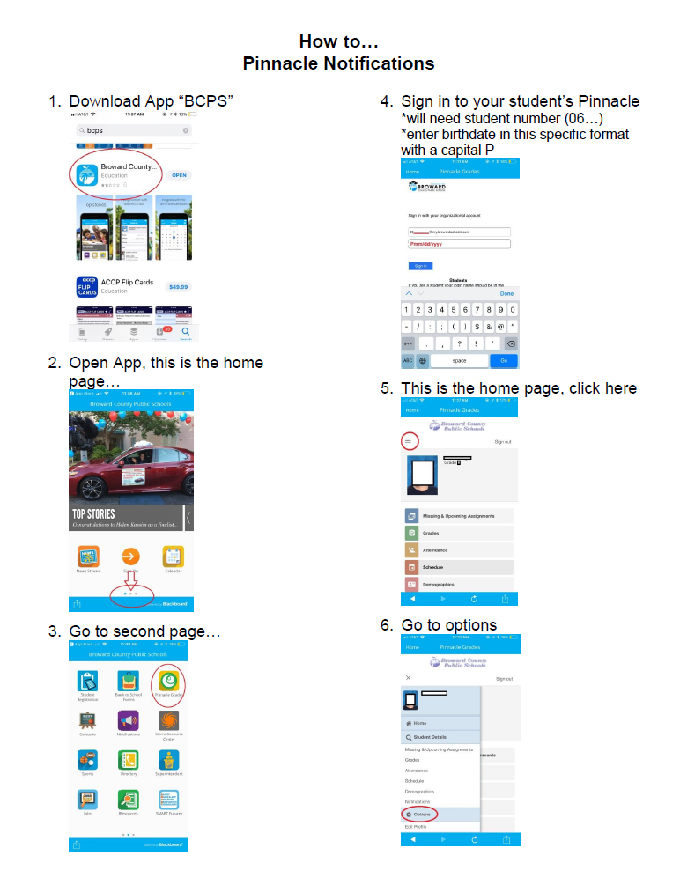
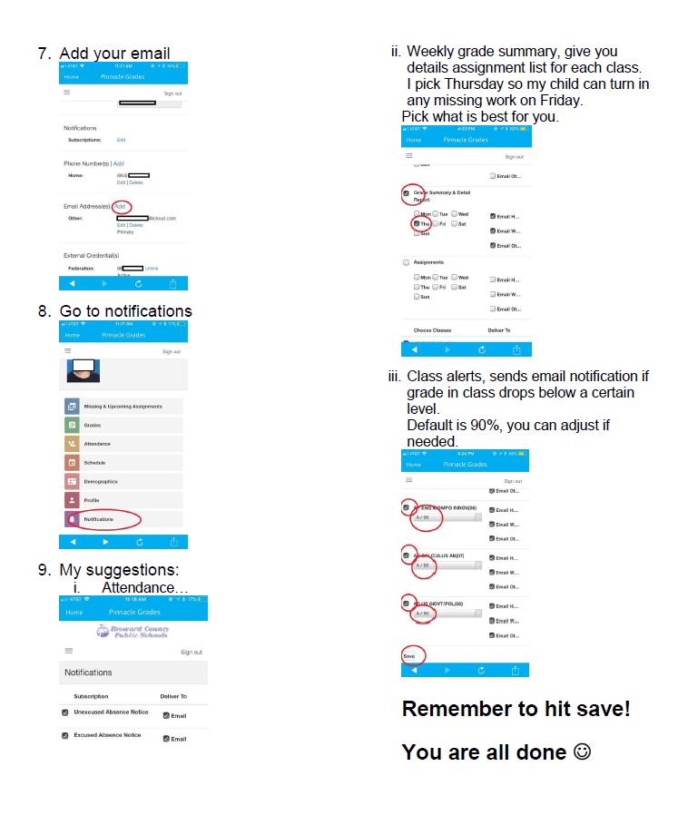
COMPONENTS
OF A
MEETING
TOPIC 4 SAMPLE HANDOUT WITH AGENDA
TOPIC 1
TOPIC 2
TOPIC 3
TOPIC 4
TOPIC 5
TOPIC 6

Slide 33
TOPIC 4 MINUTES
COMPONENTS
OF A
MEETING
Step 3: Meetings must have minutes taken.
Upload onto District website Record, maintain, and post minutes of all meetings at the school in accordance with the Florida Sunshine Laws. Policy 1.3 (12)
Document major decisions (motions) and ensure that the participants agree with your understanding of the decision.
If you’re in doubt, speak up to clarify whether a decision has been made.
Minutes must be submitted to SAC chair to be uploaded.
TOPIC 1
TOPIC 2
TOPIC 3
TOPIC 4
TOPIC 5
TOPIC 6

Slide 34
COMPONENTS
OF A
MEETING
TOPIC 4 MINUTES
Discussion items: This should include a description and potential outcome
Include the Motion, maker of the motion. Who seconded the motion. The results of the motion. (Passed unanimously, passed 5 to 3, failed 3 to 5; or failed because no one seconded the motion)
List of participants: Sign in Sheet
Generally include only what was done, not what was said. Summarize what transpired during the meeting.
Finalize the minutes in a timely fashion.
Recording Secretary: Get them to the chair as they may be needed for an Area Advisory Meeting.
TOPIC 1
TOPIC 2
TOPIC 3
TOPIC 4
TOPIC 5
TOPIC 6

Slide 35
TOPIC 4 SAMPLE MINUTES
COMPONENTS
OF A
MEETING
K.C. Wright Elementary School
School Advisory Forum Minutes
600 SE Third Ave., Ft. Lauderdale FL 33301
General Meeting - September 26, 2023
Call to order at 7:05 p.m.
Introductions were made
The minutes of August 29, 2023 were approved, as corrected.
Reports: Principal gave her report. Open house was a success, there was a large turnout. Reminder that students must be in physical attendance a minimum of one day during the FTE Attendance window.
Presentation: How does a parent access Pinnacle and Canvas. An attachment was provided on how to access Pinnacle and what Pinnacle tells them about their child.
Unfinished Business: Follow up to Here Comes the Bus app. It should be working now. District was updating the systems over the summer. There is also a shortage of bus drivers which may impact some students.
TOPIC 1
TOPIC 2
TOPIC 3
TOPIC 4
TOPIC 5
TOPIC 6

Slide 36
COMPONENTS
OF A
MEETING
TOPIC 4 SAMPLE MINUTES
New Business: Review of Area Advisory Council’s presentation on Behavioral Threat Assessment. An overview was given of the program being a preventative program and not a disciplinary one. More information can be found at browardschools.com/bta.
Motion: We move that someone from the Behavioral Threat Assessment Department come to the school to give a presentation. Made by Abe Deal, seconded by Felicia Good. Motion failed. 4 against, 3 for.
There were no additional concerns and no public input.
Announcement: Next meet October 30, 2023
Adjourned 7:35 pm.
Collect sign-in sheet.
TOPIC 1
TOPIC 2
TOPIC 3
TOPIC 4
TOPIC 5
TOPIC 6
Notes:
This is the order of an agenda according to Robert’s Rules of Order.

Slide 37
HOW
TO
GET
STARTED
TOPIC 4 MOTIONS
Step 4: What is the purpose of making motions?
A motion is a formal proposal by a member to do something. Motions are the basis of the group decision-making process. They focus the group on what is being decided.
A motion is made at a meeting when a desired action is requested.
At a School Advisory Forum meeting a conversation or concern is often discussed and as a result of that discussion a motion is formed.
TOPIC 1
TOPIC 2
TOPIC 3
TOPIC 4
TOPIC 5
TOPIC 6

Slide 38
TOPIC 4 MOTIONS
COMPONENTS
OF A
MEETING
The Chair recognizes the member wanting to make a motion.
It is suggested that the presenter making the motion put it in writing first.
Making the Motion:
Always state a motion affirmatively. Say, "I move that we ..." rather than, "I move that we do not ...".
Another member will second the motion or the Chair will call for a second.
When a second has been made the Chair will open the floor for discussion.
An amendment can be made anytime while the motion is on the floor, the amendment must have a second to proceed. Amendments must be voted on first before voting on the main motion.
If there is no second to the motion, it is lost. There is no further discussion.
TOPIC 1
TOPIC 2
TOPIC 3
TOPIC 4
TOPIC 5
TOPIC 6

Slide 39
COMPONENTS
OF A
MEETING
TOPIC 4 MOTIONS
Flow of a motion made at a
School Advisory Forum meeting:
MOTION
If it is an internal issue then it goes to the principal who addresses the motion with their staff or with District staff.
MOTION
If it is a global issue then it goes to the Area/Regional Advisory Council. It may go to the Regional Superintendent or District Advisory Council.
TOPIC 1
TOPIC 2
TOPIC 3
TOPIC 4
TOPIC 5
TOPIC 6
Notes:
There are two ways to move a motion forward.
1. If it is an internal issue then it goes to the principal who addresses the motion with their staff or with District staff.
The second way is when
The School Advisory Forum Chair brings their motion to the Area Advisory Council General Meeting. (Email motion to Area Advisory Chair first, so that it can be placed on the agenda.)
If the Area Advisory Council approves the motion,
The Area Chairperson brings the motion to the District Advisory Council.
The Area Chairperson presents the motion to the District Advisory Council membership for consideration.
The motion becomes the ownership of DAC
The District Advisory Chair presents all motions, whether passed or failed to the School Board in the DAC Chair’s report to the Board.

Slide 40
COMPONENTS
OF A
MEETING
TOPIC 4 MOTIONS
The School Advisory Forum Chair brings their motion to the Area Advisory Council General Meeting
:
MOTION
The motion is emailed to the Area/Regional Advisory Chair first, so that it can be placed on the agenda.
If the Area Advisory Council approves the motion, the Area Chair brings the motion to the District Advisory Council.
The Area Chairperson presents the motion to the District Advisory Council membership for consideration.
The motion becomes the ownership of DAC
The motion now becomes the ownership of the Council.
TOPIC 1
TOPIC 2
TOPIC 3
TOPIC 4
TOPIC 5
TOPIC 6
Notes:
There are two ways to move a motion forward.
1. If it is an internal issue then it goes to the principal who addresses the motion with their staff or with District staff.
The second way is when
The School Advisory Forum Chair brings their motion to the Area Advisory Council General Meeting. (Email motion to Area Advisory Chair first, so that it can be placed on the agenda.)
If the Area Advisory Council approves the motion,
The Area Chairperson brings the motion to the District Advisory Council.
The Area Chairperson presents the motion to the District Advisory Council membership for consideration.
The motion becomes the ownership of DAC
The District Advisory Chair presents all motions, whether passed or failed to the School Board in the DAC Chair’s report to the Board.

Slide 41
COMPONENTS
OF A
MEETING
TOPIC 4 MOTIONS
Once a motion is brought before District Advisory Council
:
MOTION
If the motion passes, the DAC Chair may form a subcommittee for further investigation.
The District Advisory Chair presents all motions, whether passed or failed to the School Board in the DAC Chair’s report to the Board.
The motion is then tracked by the Chief of Staff or his designee. The Chief of Staff sends the motion to the appropriate department head. The Chief of Staff has 21 days to respond as to the status of the motion.
TOPIC 1
TOPIC 2
TOPIC 3
TOPIC 4
TOPIC 5
TOPIC 6
Notes:
There are two ways to move a motion forward.
1. If it is an internal issue then it goes to the principal who addresses the motion with their staff or with District staff.
The second way is when
The School Advisory Forum Chair brings their motion to the Area Advisory Council General Meeting. (Email motion to Area Advisory Chair first, so that it can be placed on the agenda.)
If the Area Advisory Council approves the motion,
The Area Chairperson brings the motion to the District Advisory Council.
The Area Chairperson presents the motion to the District Advisory Council membership for consideration.
The motion becomes the ownership of DAC
The District Advisory Chair presents all motions, whether passed or failed to the School Board in the DAC Chair’s report to the Board.

Slide 42
TOPIC 5 ELECTIONS
COMPONENTS
OF A
MEETING
ELECTION PROCESS
Please see the School Advisory Forum Manual for further details.
TOPIC 5
TOPIC 1
TOPIC 2
TOPIC 3
TOPIC 4
TOPIC 6
Notes:
Veronica

Slide 43
TOPIC 5 ELECTIONS
ELECTION
PROCESS
FOR
SAF & SAC
PARENTS
The Chair and Vice-chair shall be a parent or custodial guardian of a student who will be enrolled and attending the school during their term of service.
The Chair cannot be a Broward County Public School employee* at the school where they are employed. (Refer to By Laws)
Elections must be advertised and should be held at a meeting where the most parents attend. (Example: Open house, School Advisory Forum or before a PTA/PTO, Band Booster meeting, SAC, NOT during the meeting.)
The Nominating Committee will present a slate to membership.
(Check your bylaws!)
*Denotes the requirement – that these individuals shall not be an employee of the School Board of Broward County, Florida, per the criteria of that position in accordance with applicable School Board Policy; except for a person whose employment is as a temporary substitute teacher.
TOPIC 5
TOPIC 1
TOPIC 2
TOPIC 3
TOPIC 4
TOPIC 6

Slide 44
TOPIC 6 COMMUNICATION
LOOPING
CHECK LIST
SCHOOL ADVISORY FORUM
&
SCHOOL ADVISORY COUNCIL
SAF
SAC
TOPIC 5
TOPIC 6
TOPIC 1
TOPIC 2
TOPIC 3
TOPIC 4
Notes:
Provide a contact person to whom the SAF Chair can send information to.

Slide 45
TOPIC 6 THE PUBLIC ENGAGEMENT LOOP “LOOPING” – POLICY 1164
”Looping” has been designed for use only when a major initiative or new district wide program is under consideration
Information is presented at a District Advisory Council Meeting
The information is then presented to the Area Advisories SAF Chairs
The Area Advisory Chairs provide their feedback/motion to DAC
The SAF chairs return to their Area Advisory with their feedback/motion
SAF Chairs go back to their school and vet the information with their community
DAC brings forward a motion that is read at a School Board Meeting
The motion is catalogued by the Chief of Staff and forwarded to a department for a response
A response is provided within 21 days
TOPIC 5
TOPIC 6
TOPIC 1
TOPIC 2
TOPIC 3
TOPIC 4
Notes:
Example: 1. The Attendance Policy was presented to DAC with recommendations made by the Attendance Committee.
2. The policy revisions went to the areas and then the schools.
3. Recommendations from parents came back to the Area and then to DAC
4. A recommendation was made by DAC to have the parents have the ability to email the attendance clerk instead of having to call in.
5. The end goal was to have more parents notify their school of their child’s absence.

Slide 46
C
O
M
M
U
N
I
C
A
T
I
O
N
TOPIC 6 LOOPING PROCESS
Looping of information can be:
Where the area decides to loop an issue to other schools/areas/regions to see if they have the same concerns
Where DAC decides to loop an issue back to the area/regions and then the schools to see if they have the same concerns bringing it back to DAC
Where the district needs to loop a policy change or initiative to DAC/Areas/Regions/Schools.
The looping process can start at any point. Information may be sent to the SAF chairs or the Area/Regional Advisory Council first in order to expedite the process.
TOPIC 1
TOPIC 2
TOPIC 3
TOPIC 4
TOPIC 5
TOPIC 6

Slide 47
C
O
M
M
U
N
I
C
A
T
I
O
N
TOPIC 6 PLAN THE MEETING CHECKLIST
The School Advisory Forum Manual provides information on various topics.
What is going on at their school.
What is going on at the district.
What changes are being made to policies that will affect their child.
PLAN THE MEETING
_____ Meet the principal
_____ Meeting dates established and advertised
_____ Contact guest speaker
_____ Agenda development and distribution
TOPIC 6
TOPIC 1
TOPIC 2
TOPIC 3
TOPIC 4
TOPIC 5

Slide 48
C
O
M
M
U
N
I
C
A
T
I
O
N
TOPIC 6 MEETING CHECKLIST
OPERATE THE MEETING
_____ Start on time
_____ Guidelines should be established and conveyed to group as the meeting begins
_____ Discuss one item at a time and move on (avoid getting side-tracked)
_____ Get input from the group
_____ Summarize decisions
_____ Review follow-up responsibilities and deadlines
FOLLOW UP
_____ Minutes should be shared and posted in a timely manner
_____ Make sure speakers/presenters are thanked
TOPIC 5
TOPIC 6
TOPIC 1
TOPIC 2
TOPIC 3
TOPIC 4

Slide 49
C
O
M
M
U
N
I
C
A
T
I
O
N
TOPIC 6 VOTING RIGHTS
VOTING RIGHTS:
Meetings are open to all, but voting rights are granted only to members who are parents or guardians of students who are enrolled in the school or matriculating to the school the following year, students of the school, employees of the school and business partners of the school. To vote at any meeting, members must sign in, present proof that they meet the voting membership requirements, if requested.
Policy 1.3 (D)
TOPIC 5
TOPIC 6
TOPIC 1
TOPIC 2
TOPIC 3
TOPIC 4

Slide 50
TOPIC 6 SAC AND SAF RELATIONSHIP
SAC & SAF Chairs should discuss what will be covered in their two joint meetings.
Sharing of information
Joint training should occur on the following topics…
What is a School Advisory Council Member
Review Bylaws & Policy 1403
What is a School Advisory Forum Member
Review Bylaws & Policy 1.3
Review & sign School Budget
School Accountability Funds
Review of the School Improvement Plan
TOPIC 5
TOPIC 6
TOPIC 1
TOPIC 2
TOPIC 3
TOPIC 4
Notes:
Carolyn – One of the first meetings could address the benefits of SAC & SAF. Review each of the polices and bylaws for each committee.

Slide 51
TOPIC 6 SAC AND SAF HISTORY
1976 - The School Board passed Poicies 1.2 - District Advisory Council and 1.3 – School Advisory Council.
1991 - The Legislature created Florida’s system for school improvement and accountability. This committee was referred to as the School Improvement Team (SIT).
1998 - the State Legislature passed a bill stating: “Each school advisory council shall include in its name the words "school advisory council."
2000 - Policy 1.3 School Advisory Council’s named was changed to School Advisory Forum and School Improvement Team was changed to School Advisory Council.
In 1998 HB 3901 was
229.58 District and school advisory councils.-
(1) ESTABLISHMENT.-
(a) The school board shall establish an advisory council for each school in the district, and shall develop procedures for the election and appointment of advisory council members. Each school advisory council shall include in its name the words "school advisory council." The school advisory council shall be the sole body responsible for final decision making at the school relating to implementation of the provisions of ss. 229.591, 229.592, and 230.23(16). (Renamed ss. 1001.452)
TOPIC 5
TOPIC 6
TOPIC 1
TOPIC 2
TOPIC 3
TOPIC 4
Notes:
One of the first meetings could address the benefits of SAC & SAF. Review each of the polices and bylaws for each committee.

Slide 52
THANK YOU
We would like to take this opportunity to thank you for your dedication and commitment to the students of Broward County Public Schools.
YOU MAKE A DIFFERENCE!

Slide 53
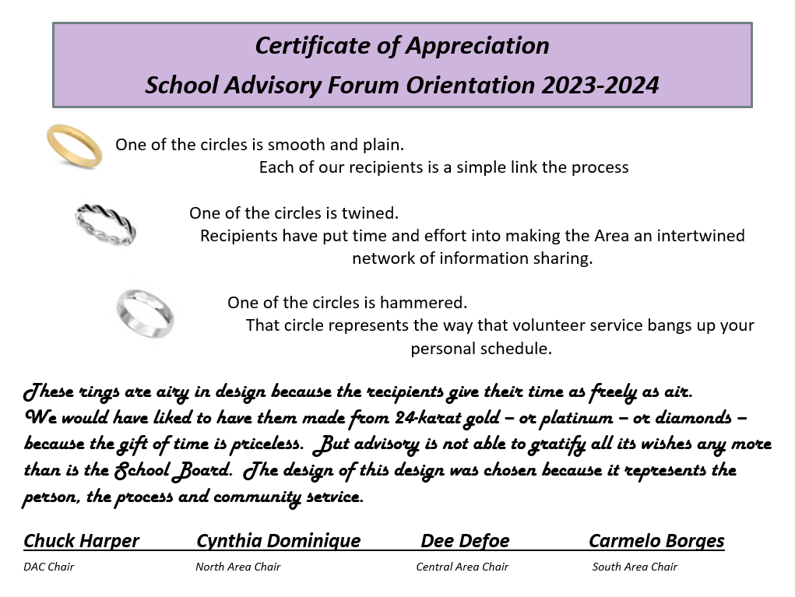
ne of the circles is smooth and plain.
Each of our recipients is a simple link in the process

